Slide 1
RADAR CHART

Slide 2
What is Radar chart?
Radar Charts are a way of comparing multiple quantitative variables.
Each variable has its own axis, all axes are joined in the center of the figure.
It is also called known as Spider Chart or Web Chart or Polar Chart or Star Plots.

Slide 3
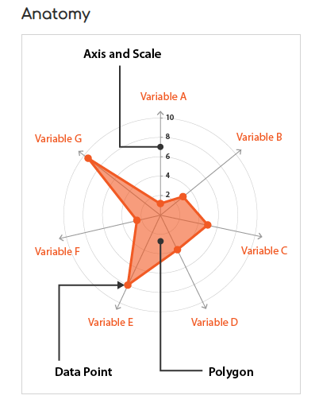

Slide 4
Radar charts:
Each variable is provided with an axis that starts from the centre.
All axes are arranged radially, with equal distances between each other, while maintaining the same scale between all axes.
Grid lines that connect from axis-to-axis are often used as a guide.
Each variable value is plotted along its individual axis and all the variables in a dataset and connected together to form a polygon.

Slide 5
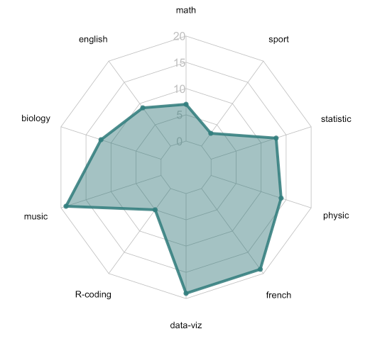
Example:
Marks obtained by a student in various subjects

Slide 6
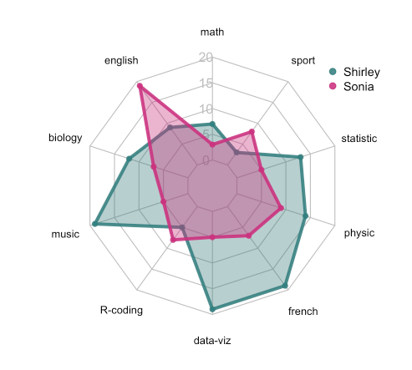
Comparing multiple data points:
Comparing marks obtained by two students in various subjects

Slide 7
Advantages:
Useful for seeing which variables have similar values or if there are any outliers
amongst each variable.
Useful for seeing which variables are scoring high or low within a dataset, making
them ideal for displaying performance.

Slide 8
Disadvantages:
Having multiple polygons in one Radar Chart makes it hard to read, confusing and too cluttered. Especially if the polygons are filled in, as the top polygon covers all the other polygons underneath it.
Having too many variables creates too many axes and can also make the chart hard to read and complicated. So it's good practice to keep Radar Charts simple and limit the number of variables used.
harder to read - quantitative values are much easier to compare when they are laid out along a single vertical or horizontal axis.

Slide 9
Tools:
R
Amcharts
Chart.js

Slide 10
References:
https://datavizcatalogue.com/methods/radar_chart.html
https://www.data-to-viz.com/caveat/spider.html
https://www.fusioncharts.com/resources/chart-primers/radar-chart

Slide 11
THANK YOU

